Slide 1
INDONISIA-CHINA TRADE RELATIONS:WIN-WIN COOPERATION
WANG Yonghui
Central China Normal University

Slide 2
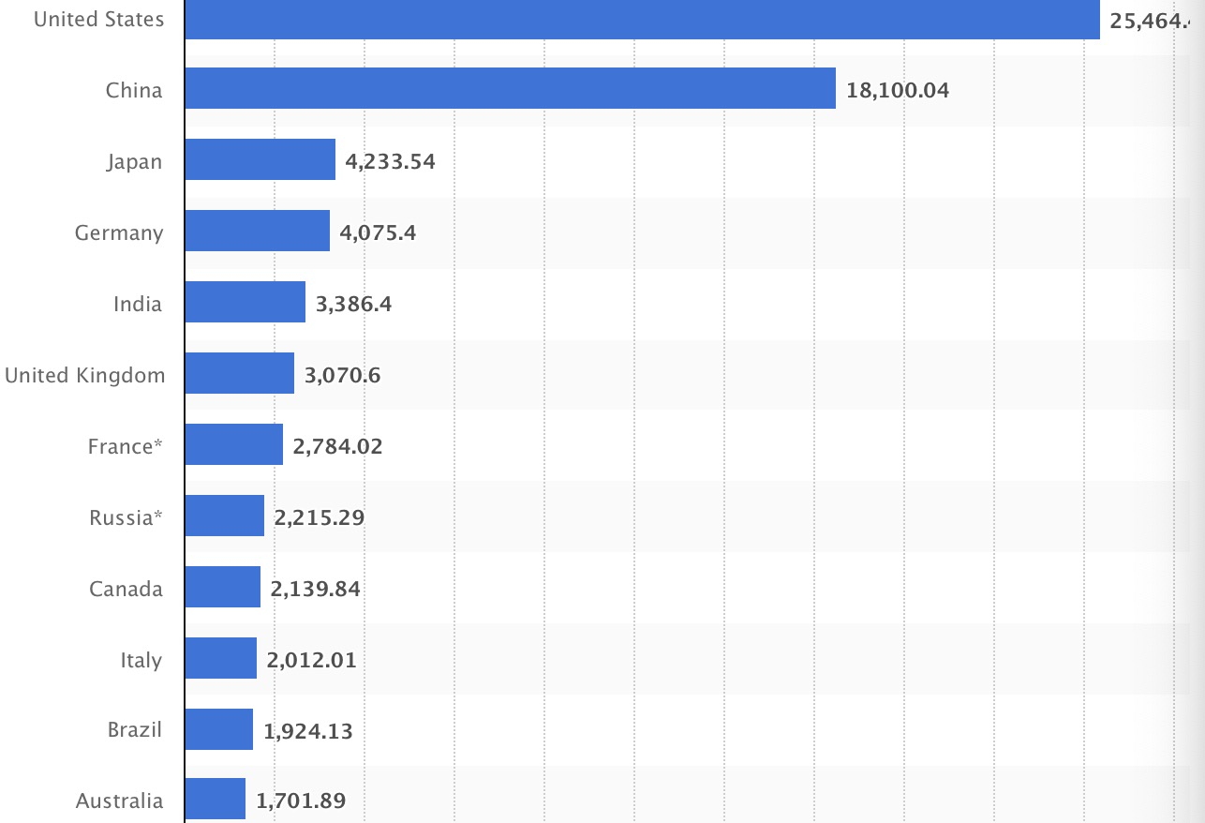
The 20 countries with the largest gross domestic product (GDP) in 2022 (in billion U.S. dollars)

Slide 3
Resorces :IMF

Slide 4
China has become Indonesia’s biggest trade parterner since 2013
In 2022, the bilateral trade volume between China and Indonesia reaches US$149.1 billion, a year-on-year increase of 19.8%.

Slide 6
China has become Indonesia’s biggest trade parterner since 2013
In 2022, the bilateral trade volume between China and Indonesia reaches US$149.1 billion, a year-on-year increase of 19.8%.

Slide 7
China is the second largest foreign investor now, and may become the largest one in the coming few year.
China’s investment in Indonesia reached about USD 8.2 billion in 2022.
Mobile: Wuling
Power station
Kereta Cepat Jakarta Bandung(KCBJ,Woosh)
Kereta Cepat Jakarta Surabaya

Slide 8
Indonesia-China Cooperation Potential
E-commerce
Online shop cooperation:Titik Tok + Douyin
EV Mobile/ Motor/Bus
BYD remains top 1 with over 548,000 units sold in Q1 and a 21.3 percent share. The Chinese manufacturer almost doubled its volume year-over-year and noticeably increased its market share compared to Q1 2022.

Slide 10
Nusantar’s Future: New capital Construction
Over 35 billion US dollars
newest technology

Slide 11
AI tecnolegy
USA and China are leading countries in AI tecnology
2023 London AI Summit

Slide 13
Maritine Cooperation
Sea Port construction
Ocean exploration： Earth Quake prediction
Marine life research and development

Slide 14
WORLD RANKING OF THE 10 LARGEST CONTAINER PORTS
Top 1. Shanghai (China): 47.28 M TEU +0.5% compared to 2021
Top 2. Singapore (Singapore): 37.29 M TEU -0.5% compared to 2021
Top 3.Ningbo-Zhoushan (China): 33.36 M TEU -6.8% compared to 2021
Top 4. Shenzhen (China): 30.04 M TEU +4.3% compared to 2021
Top 5. Qingdao (China): 25.66 M TEU +7.6% compared to 2021
Top 6. Guangzhou (China): 24.60 M TEU +1.7% compared to 2021
Top7. Busan (South Korea) 22.07 M TEU -2.9% compared to 2021
Top 8. Tianjin (China): 21.03 M TEU +3.7% compared to 2021
Top 9.Los Angeles-Long Beach (United States): 19.04 M TEU -5.3% compared with 2021
Top 10.Hong Kong (China): 16.64 M TEU -7.0% compared to 2021

Slide 15
Thank you

